Slide 1
Analyzing and Visualizing Regional Sales Performance
For ABC Electronics

Slide 2
Problem Statement
ABC Electronics wants to assess its sales performance across different regions and product categories. The management needs a summarized report with visual insights to identify top-performing regions, products, and trends. As a business analyst, your task is to clean the data, analyze it using formulas, and create a basic dashboard that provides actionable insights.

Slide 3
Objectives
Clean and prepare data for accurate analysis.
Analyze sales and profit by region and product category.
Evaluate discount impact on sales and margins.
Identify sales trends over time.
Track key metrics like total sales, profit, and quantity sold.
Provide insights for marketing and inventory decisions.
Create a simple dashboard with visuals for decision-making.

Slide 4
Methodology
Clean and Prepare the Data
Remove duplicate entries and fix any errors or missing values.
Format the data properly (e.g., correct dates, numbers, and text formats).
Make sure all the data is consistent and ready for analysis.
Analyze Sales and Profit by Region and Product Category
Group the data by region and product category.
Calculate total sales and profit for each group.
Compare performance across different regions and categories.
Evaluate the Impact of Discount on Sales and Margins
Check how discounts affect sales volume.
Analyze whether higher discounts lead to lower or higher profit margins.
Look for patterns between discounts and overall business performance.

Slide 5
4. Identify Sales Trends Over Time
Organize sales data by time (monthly, quarterly, yearly).
Use charts to see how sales change over time.
Spot any seasonal trends or growth patterns.
5. Track Key Metrics
Monitor total sales, total profit, and quantity of items sold.
Calculate average values for a better understanding.
Use these metrics to measure overall business health.
6. Provide Insights for Marketing and Inventory Decisions
Use analysis to identify high-performing products and regions.
Recommend where to increase marketing efforts.
Suggest inventory adjustments based on demand and sales patterns.

Slide 6
Overall Sales
OverAll Profit
10.11
4.03
Millions
Millions
OverAll Quantity
OverAll Orders
1.03
4001
Lakhs
Thousand

Slide 7
Top-Performing Regions
Region | Sales Amount | Profit
East | 2.59M | 1.05
North | 2.54M | 970
South | 2.49M | 1.01
West | 2.48M | 999
The East region had the highest sales and profit, with sales of around 2.59 million and profit over 1.05 million.

Slide 8
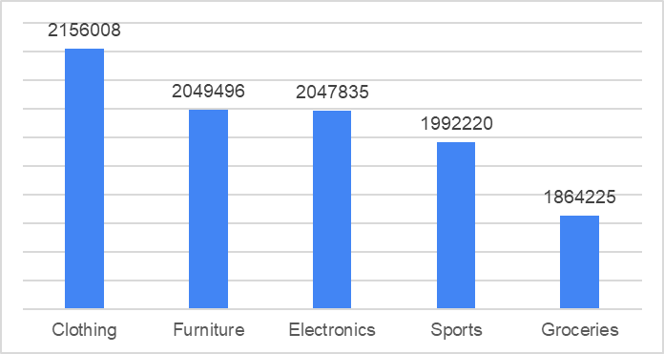
Top-Performing Categories
Among all product categories, Clothing performed the best with sales reaching around 2.16 million and profit of about 856 thousand. It was followed closely by Furniture and Electronics, which also showed strong numbers.

Slide 9
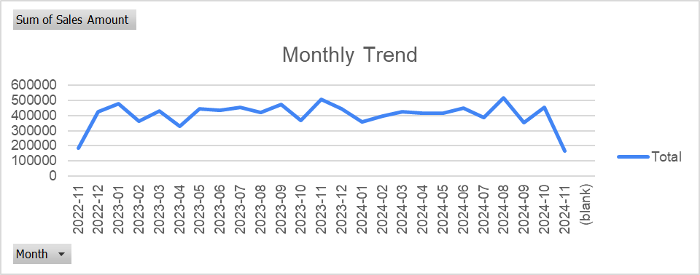
Monthly Sales Trend
This chart shows the total sales amount for each month from November 2022 to November 2024. The sales stayed mostly steady, with some months having higher sales, like February 2023 and August 2024.
In November 2024, sales dropped a lot, and there is also a blank month, which may mean the data is missing. Overall, sales were stable with a few ups and downs.

Slide 10
Impact of discounts on sales and profit margins.
Discounts can help boost sales, but their impact on profit is mixed, moderate discounts (around 12% to 25%) often lead to higher profits, while very high discounts (above 40%) tend to reduce profitability without consistently increasing sales. Overall, the analysis shows that carefully applied, mid-range discounts strike a balance between encouraging purchases and maintaining healthy profit margins, whereas deep discounting may hurt the bottom line without delivering proportional gains in revenue.

Slide 11
Recommendation
1. Put More Ads in the East The East region is buying the most and making the most profit. So, it's a good idea to spend more on ads and offers for customers in this area.
2. Keep Extra Stock of Clothing and Furniture Clothing and Furniture are the best-selling and most profitable products. Make sure you always have enough of these in stock, especially before busy months.
3. Use Medium Discounts Giving discounts between 10% and 25% helps you make good profit. Try not to give really big discounts unless you're clearing out old stock.

Slide 12
4. Plan Sales for August to October Sales are highest in late summer and early fall. That’s the best time to run big promotions or new product launches.
5. Highlight Furniture as a Premium Product Furniture makes the most profit. Market it as a high-quality product and show people the value they get when they buy it.
6. Restock Groceries Often, But Don’t Overdo It Groceries sell quickly, but they don’t make as much money. Restock them regularly, but be careful not to order too much at once.

Slide 13
THANK YOU

